Slide 1
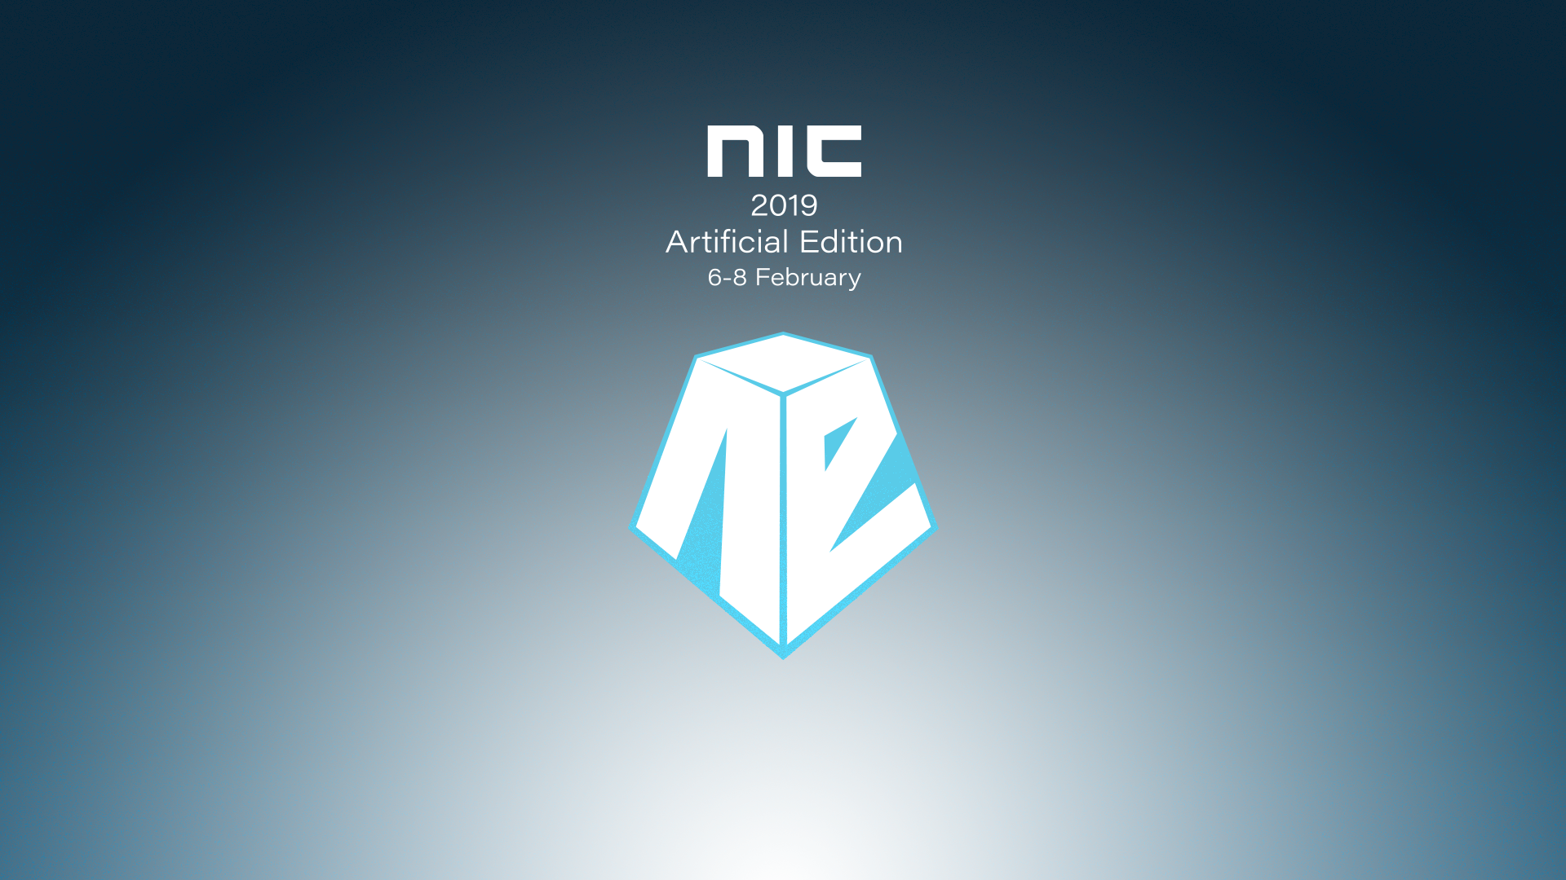

Slide 2

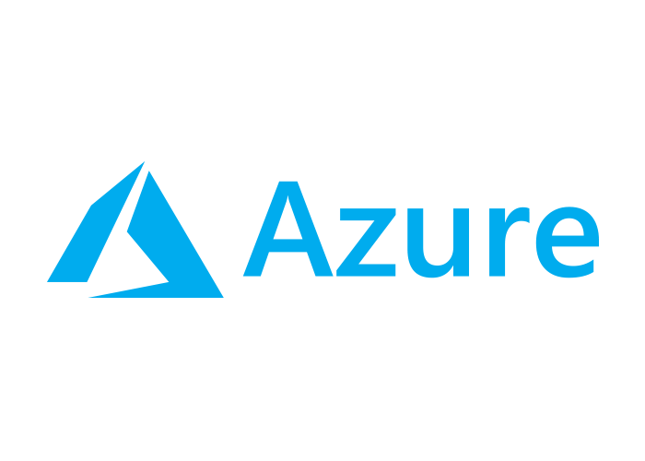



Cloud Wars A Technical Comparison between Azure, Amazon, Google and IBM
Marius Sandbu Technical Cloud Lead @ EVRY

Slide 3






Some projects I’ve been and are working on

Slide 4
Agenda
View of the landscape – And the big new
Overview of Microsoft, Amazon, Google and IBM
Technical Comparison
Performance Comparison
Which to choose?

Slide 5

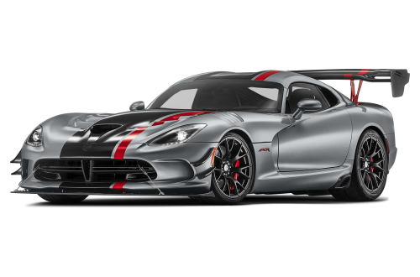
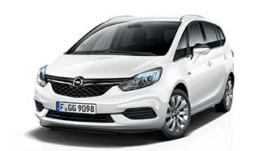
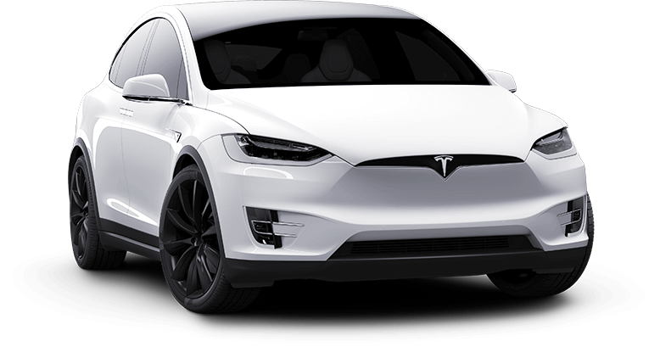
All Clouds are built differently

Slide 6
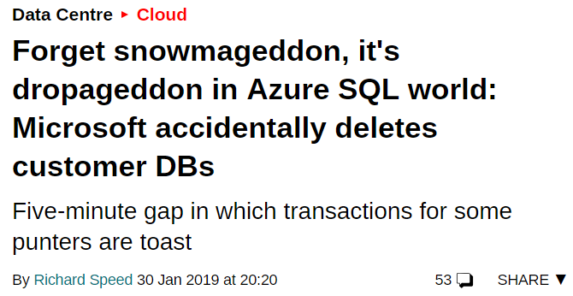
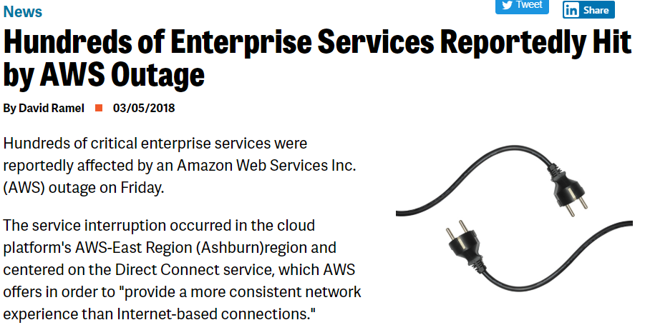
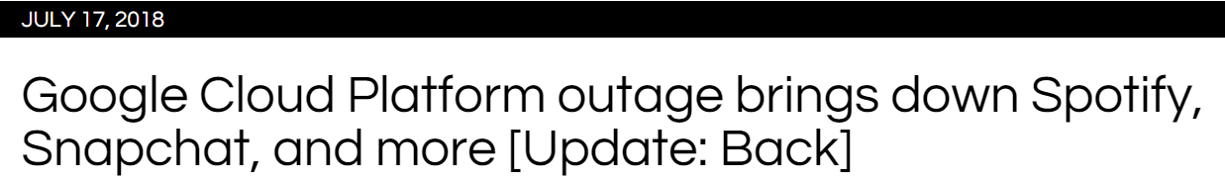
And like most they too have bad days..

Slide 7
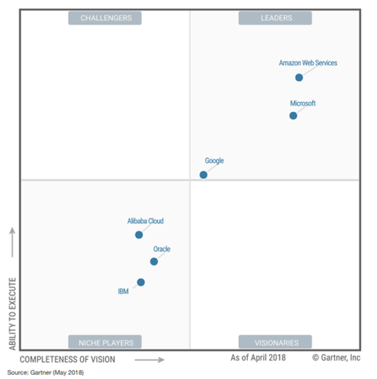
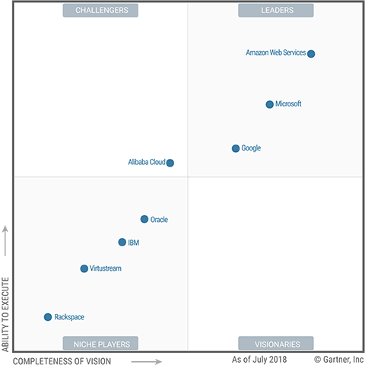
What is Gartner saying?
Infrastructure as a service
Public Cloud Storage

Slide 8



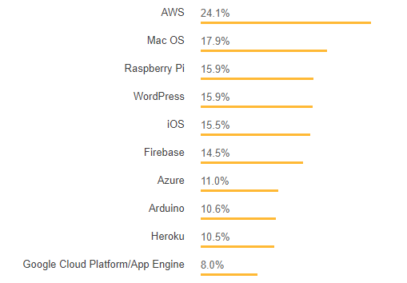



What is the community saying?

Slide 9
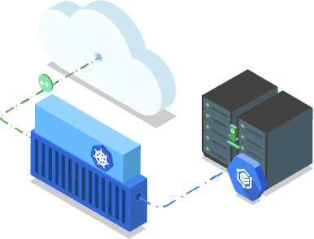
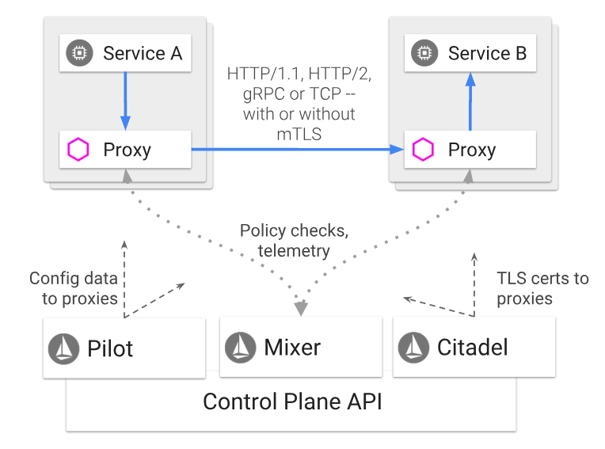
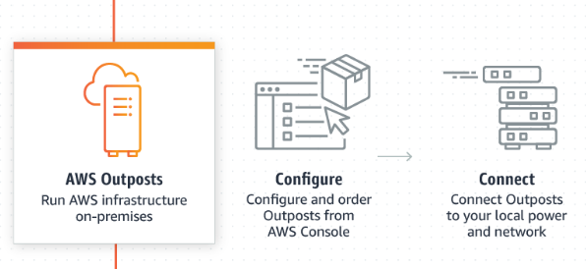
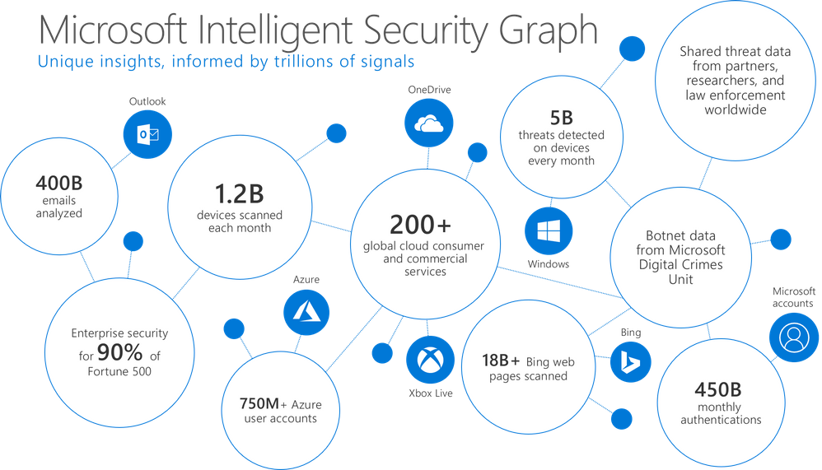
So what’s the big new the last year?
New Regions! (Sweden, Finland, Norway)
Amazon and Hybrid
AWS Outposts
Amazon RDS on Vmware
Google and Cloud Services Platform
GKE On-premises
Microsoft and Security Investments
Azure Stack
IBM and Container workloads

Slide 10


Overview Microsoft Azure and AWS
DevOps and Containers
Big data and Analytics
Identity
EUC and Security
Hybrid
VMware and Hybrid
Security
DevOps and Containers
Machine Learning
Core services updates

Slide 11

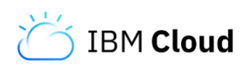
Overview Google Cloud Platform
Devops and Containers
Hybrid
Application Platforms
Core infrastructure
ML & IOT
Bare metal offerings
Merging Bluemix and Softlayer
3 Party offerings
Machine Learning
IBM Private Cloud

Slide 12
Technical Comparison
Does not reflect on
Maturity
Quality
Performance
Cost
Last updated: 08/02 – 08:11…

Slide 13
Technical Comparison - Availability
Provider | Microsoft | Google | Amazon | IBM
EMEA Regions | Ireland, Netherlands, Wales, UK, Germany x3, Franke and Switzerland (coming) Norway (Coming) | UK, Germany, Finland Belgium & Netherlands. | Ireland, Germany, UK | UK, Germany (Bluemix) Netherlands, Italy, Norway.
ASIA & Oceania Regions | 13 Regions | 4 Regions | 5 Regions | 1 Region (Bluemix) 7 Regions Softlayer
South America Regions | 1 Region | 1 Region | 1 Region | 1 Region Softlayer
North America Regions | 16 Regions | 7 Regions | 5 Regions | 1 Region (Bluemix) 8 Regions Softlayer
Upcoming Regions | Switzerland, South Africa, Australia, UAE | Japan, Switzerland, Hong Kong | Hong Kong, Sweden
Total regions | 54 (With Upcoming regions) | 18 (With Upcoming regions) | 21 (With Upcoming Regions) | 11 (With Upcoming regions)
Point of Presence | 129 PoP | 134 PoP | 166 PoP (Yesterday) | 37 PoP
Availabilty Zones support | Yes | Yes | Yes | Yes (For some)

Slide 15
Technical Comparison – Availability MAP
IBM Cloud
Google Cloud
Amazon Web Services
Microsoft Azure

Slide 16
Technical Comparison - Compliance
Provider | Microsoft | Google | Amazon | IBM
ISO 27001 | X | X | X | X
ISO 27017 | X | X | X | X
ISO 27018 | X | X | X | X
PCI-DSS | X | X | X | X
Cloud Security Alliance (CSA) | X | X | X | X
GDPR | X | X | X | X
FedRamp | X | X | X | X
HIPAA | X | X | X | X

Slide 17
Technical Comparison - Compute
Provider | Microsoft | Google | Amazon | IBM
High Performance Computing Services | Azure Batch, Azure CycleCloud |  | Amazon Batch | IBM Spectrum, IBM Aspera
Reserve Capacity instances | Low Priority VM’s | Preemptible instance | Spot instances
Reserved Instances | Reserved Instances | Committed use | EC2 Reserved Instances
Dedicated instances |  | Sole Tenant Nodes | EC2 Dedicated Instances
Dedicated hosts | For SAP Only | For SAP Only | EC2 Dedicated Hosts | Dedicated Hosts available
Bare Metal hosts |  |  | Yes (Announced) | Yes
Burstable Instances | Yes | Yes | Yes | No
Metadata support | Yes | Yes | Yes | Yes
Custom Instance Sizes |  | Yes |  | Yes
Compute Service Identity | Yes | Yes | Yes | No
Secure Computing | Confidential Computing | Shielded VM’s

Slide 18
Technical Comparison - Compute
Provider | Microsoft | Google | Amazon | IBM
High Performance disk | Premium Disk, SSD Standard, UltraDisk | SSD persistent disk, Local SSD | SSD EBS | SSD Octane
GPU-instances | N-series | Flexible GPU | P2 & P3 instances / Flexible GPU | Flexible GPU
GPU cards support | M60, K80, P40, P100, V100 | T4, K80, P100, V100, P4 | M60, Custom GPU, V100, K80 | V100, P100, M60, K80
Desktop as a service | Windows Virtual Desktop (Coming*) | Third party | Workspaces & AppStream | Third Party
Scaling | VM Scale Set | Instance Group | Auto Scaling | Auto Scale
Godzilla VM | Standard_M128 128vCPU, 3,8TB Memory (18 TB coming for SAP) | N1-highmem 160vCPU, 4TB Memory (12 TB Coming for SAP) | X1.32large 448vCPU, 12 TB Memory (SAP) | 64 vCPU, 512 GB Memory (Other Bare Metal)
VMware support | No (Announced) | No | Yes | Yes (Only Softlayer)
Billing for VM | Per Second | Per Second | Per Second | Per Minute

Slide 19
Technical Comparison – Development Platforms
Provider | Microsoft | Google | Amazon | IBM
Container as a service | Azure Container Instances |  | Amazon Fargate
Container Management | Azure Container Service Azure Kubernetes Engine | Google Kubernetes Engine | EC2 Container Service, Amazon EKS | Cloud Kubernetes Service
Service Mesh |  | Part of GKE | App Mesh (Preview) | Park of CKS
Container Registry service | Yes | Yes | Yes | Yes
CI/CD Pipeline | Azure DevOps | Cloud Build | CodePipeline / CodeBuild
App services | Azure App Service | Google App Engine | Elastic Beanstalk | Cloudfoundry
Source Code Repository | Azure DevOps | Cloud Source Repositories | AWS CodeCommit | IBM UrbanCode
Event drive Compute | Azure Functions | Cloud Functions | Lambda | IBM Functions
API Gateways | API Management | Cloud Endpoint & Apigee | Amazon API Gateway | API Connect

Slide 20
Technical Comparison – Migration and backup services
Provider | Microsoft | Google | Amazon | IBM
VM Migration Services | Azure Site Recovery, Azure Migrate | Third party (CloudEndure) | VM import, VM migration service (CloudEndure*) | IBM Cloud Migration
Storage Migration Service | Online Data Import | Cloud Storage Transfer Service | AWS DataSync
Storage Migration Appliance | Offline Data Import, Azure Data Box | Cloud Data Transfer Appliance | Snowmobile, SnowBall, Snowball Edge | Mass data migration
On-premises to Cloud DR services | Azure Site Recovery |  | *CloudEndure
Cloud to Cloud DR services | Azure Site Recovery |  | *CloudEndure
Backup IaaS | Azure Backup | Snapshot Disk | AWS Backup *CloudEndure | Third party
Backup Hybrid | Azure Backup |  | *CloudEndure
Other offerings | UI Migration & CLI | UI migration & CLI | UI migration & CLI
*CloudEndure aquired by AWS

Slide 21
Technical Comparison – Storage Services
Provider | Microsoft | Google | Amazon | IBM
Max Disk Size | 64 TB (Ultra Disk) | 64 TB (Persistent Disk) | 16 TB (EBS) | 12 TB (SAN)
Max Throughput and IOPS per disk | 2000 MBps / 160,000 IOPS | 1200 MBps / 60,000 IOPS | 1000 MBps / 80000 IOPS | 48000 IOPS
Customizable IOPS | No | Yes | Yes | No
Object Storage service | Azure Blob Storage | Google Cloud Storage | Amazon S3 | Cloud Object Storage
Archive Tier | Cold & Archive Storage | Coldline Storage | Glacier, Deep Archive | Vault, Cold Vault
Geo based replication | Yes | Yes | Yes | Yes
Network file Storage | Azure Files (SMB 3.0) NetApp Files | Filestore (NFS) | Amazon EFS (NFS) FSx for Windows (SMB) | File Storage (NFS)
Storage tiering policy | Storage Tiering | Lifecycle Management | S3 Lifecycle policy | No
Encryption at rest | Yes (Default) | Yes (Default) | Yes (EFS and S3 ) | Yes
Hybrid Storage | Azure DataBox, Azure File Sync |  | Storage Gateway Snowball Edge,
SFTP Service |  |  | Yes

Slide 22
Technical Comparison – Identity and MDM
Provider | Microsoft | Google | Amazon | IBM
Active Directory based service | Azure Active Directory Domain Services |  | AWS Active Directory Service
Identity Service | Azure Active Directory | Google IAM | Amazon IAM | Cloud IAM
SAML (SP and IdP) support | X | X | X | X
MFA support | X | X | X | X
Conditional Access | X
Key (Secrets) Storage | Key Vault | Cloud KMS | Key Management Service | IBM Key Protect
Role based access control | X | X | X | X
Mobile Device Management | X | X
Mobile Application Management | X | X

Slide 23
Technical Comparison – Network and Security
Provider | Microsoft | Google | Amazon | IBM
TCP based load balancing | X | X | X | X
HTTP based load balancing | X | X | X | X
Content based load balancing | Web Application Gateway | Content Based Load Balancer | Application Load Balancer | Third Party, NetScaler
CDN + Load Balancing | Azure Frontdoor, Azure CDN | Google CDN | AWS Global Accelerator, Cloudfront,
DNS Based Load Balancing | Traffic Manager | X | Route53 | X
Hybrid HSM | X | X (Beta – Cloud HSM) | X
Security monitoring | Security Center | Cloud Security Center (Beta) | Amazon Inspector, Security Hub, Guard Duty | Security Advisor (Beta)
VPN | Yes | Yes | Yes | Yes
VWAN | Azure VWAN
Service endpoints | Yes | Yes, Service Controls (Beta) | Yes | Yes

Slide 24
Technical Comparison – Network and Security
Provider | Microsoft | Google | Amazon |  | IBM
Virtual machines instances with accelerated interfaces | Yes (RDMA) | Intel DPDK | Yes (Elastic network adapter) |  | Intel DPDK
Virtual Network Availability | Region | Globally | Region |  | Region
VNET Peering | Yes | Yes | Yes
DNS Hosting | Azure DNS | Cloud DNS | Route 53 |  | IBM Cloud DNS
Direct Connectivity | ExpressRoute | Cloud InterConnect | Direct Connect |  | Direct Link
CDN Support | Yes | Yes | Yes |  | Yes
HSM | Dedicated HSM | CloudHSM (Beta) | Cloud HSM |  | Cloud HSM
Web Application Firewall | Application Gateway | Google WAF (Beta) | AWS WAF |  | Third party
Firewall | Azure Firewall
DDOS Shield | Azure DDOS | Cloud Armor (Beta) | AWS Shield |  | IBM Cloud DDOS
SSL Offloading | Application Gateway | Google Cloud Load Balancing | AWS WAF |  | IBM Cloud Load Balancer

Slide 25
Technical Comparison – Media Services
Provider | Microsoft | Google | Amazon | IBM
Rendering | Azure Batch Rendering |  | AWS Media Services
Transcoding | Azure Media Services, Media Clipper |  | Elastic Transcoder
Streaming Services | Azure Media Services |  | Elemental Media Services, MediaConnect
AR & VR Services |  |  | AWS Sumerian
Programmable Voice Control | Cortana | Google Voice for Enterprise | Alexa for Business

Slide 26
Technical Comparison – Management
Provider | Microsoft | Google | Amazon | IBM
Deployment & Automation | Azure Resource Manager | Google Deployment Manager | Cloudformation | Terraform Provider
Policies og Governance | Azure Blueprints |  | AWS Control Tower, AWS Security Hub
CLI interface | PowerShell, AzureCLI, Cloud Shell | GCloud CLI, Cloud Shell | AWS CLI | Bluemix CLI
Management and logging | Azure Monitor, Log Analytics | StackDriver | CloudWatch, Cloudtrail | Monitoring and Analytics
Cost Optimization | Azure Advisor | Native Service | Trusted Advisor
Automation tools | Azure Automation | Cloud Scheduler | Amazon CloudOps for Chef and Puppet | Cloud Automation, Workload Scheduler
Configuration Management Ecosystem | Chef, Puppet, Terraform, Ansible, SaltStack | Chef, Puppet, Terraform, Ansible, SaltStack | Chef, Puppet, Terraform, Ansible, SaltStack | Terraform
Cloud Shell support | Yes | Yes
EDI Tools | Azure Logic Apps
Licensing |  |  | AWS License Manager

Slide 27
Technical Comparison – Machine Learning API’s
Provider | Microsoft | Google | Amazon | IBM
Machine learning API sets | Cognitive Services | Cloud AI | Amazon AI | Watson
Speech API | Yes | Yes | Yes | Yes
Text Analytics API | Yes | Yes | Yes | Yes
Image recognition API | Yes | Yes | Yes | Yes
Image – train your own model | Yes (Custom Vision) | Yes (AutoML) | Yes (SageMaker Ground Truth)
Emotion API | Yes | Yes | Yes | Yes
Video API | Yes ( limited) | Yes ( Limited) | Yes
Translation API | Yes | Yes | Yes | Yes
Genomics API |  | Yes
Language Translation API | Yes | Yes | Yes
Document Conversion API |  |  | Yes | Yes
DLP API |  | Yes
Forecast |  |  | Yes*

Slide 28
Technical Comparison – Machine Learning Framework
Provider | Microsoft | Google | Amazon | IBM
Machine learning service | Azure Machine Learning | Google Cloud Machine Learning Engine | Amazon Machine Learning, AWS Sagemaker | IBM Watson Machine Engine
Service language / Framework | R, Python, CNTK | Tensorflow & Python | Tensorflow, MXnet
R-integrations | SparkR, AzureSMR, ScaleR | BigRQuery, SparkR, googleComputeEngineR, GoogleCloudStorageR | SparkR, Dplyr, Aws.s3 | SparkR
Data Scientist Virtual Machine | Azure Data Science Virtual Machine | Google Data Lab | Deep Learning AMI | Data Science Experience
Bot Service | Azure Bot Service | Dialogflow | Amazon Lex | Watson Conversation Service

Slide 29
Technical Comparison – Big Data & Analytics
Provider | Microsoft | Google | Amazon | IBM
Visualization | PowerBI | DataStudio | QuickSight | Watson Analytics
Real Time Analytics | Azure Stream Analytics / Data Lake Analytics, DataBricks |  | Amazon Kinesis | Streaming Analytics
Apache Managed Services | Hadoop, Hbase, Storm, Spark, Kafka & Hive | Hadoop, Storm, Pig & Hive, Spark | Hadoop, Hbase, Storm, Spark, Kafka & Hive | Spark, Hadoop*
Apache service name | HDInsight, DataBricks | DataProc/DataFlow | Amazon EMR, Amazon Kafka | BigInsight
HDFS | Data Lake v2 (GA Yesterday) | Cloud Storage | EMRFS, AWS Lake Formation(*)
Data Orchestration | Data Factory | DataFlow, Cloud Composer | Data Pipeline | Data Connect
ETL | Data Factory | DataPrep, Cloud Composer | AWS Glue | Data Connect
Search | Azure Search | Cloud Search (Beta) | Amazon CloudSearch, Elastisearch

Slide 30
Technical Comparison – Big Data & Analytics
Provider | Microsoft | Google | Amazon | IBM
SQL Database | Azure SQL, Managed SQL Instance, | Google Cloud SQL, Cloud Spanner | Amazon RDS | Db2 Engine
SQL Engine support | MSSQL, PostgreSQL & MySQL | MySQL, PostgreSQL | MySQL, Oracle, MSSQL PostgreSQL | MySQL, PostgreSQL
Oracle support | IaaS | IaaS | IaaS and RDS | IaaS only
NoSQL Database | DocumentDB, Cosmos DB. | Google Cloud Bigtable, Cloud DataStore | DynamoDB | MongoDB, Cloudant
Datawarehouse | SQL Data Warehouse | Google BigQuery | RedShift | dashDB
Caching | Redis Cache | App Engine MemCache* | Elasticache | Redis
SQL analytics | Azure Analysis Services | Google BigQuery | Athena | dashDB Analytics
Blockchain |  |  | Managed Blockchain

Slide 31
Technical Comparison – IoT and Services
Provider | Microsoft | Google | Amazon | IBM
IoT hub | Azure IoT Hub | Google Cloud IoT | AWS IoT Core | IBM Watson IoT
IoT management and security devices | Yes | Yes (Beta) | Yes | Yes
IoT SaaS tjeneste | IoT Central |  | IoT Things Graph
IoT protocol support | MQTT, MQTT, WebSockets, HTTP, AMQP | HTTP, MQTT | MQTT, HTTP, WebSocket | HTTP, MQTT
Edge Computing | Azure Edge IoT, Azure Streaming Analytics on Edge | Cloud IoT Edge | AWS Greengrass
Edge devices | Azure Sphere | Edge TPU | Amazon FreeRTOS
Real Time Analytics of messaging | Time Series Insight |  | AWS IoT Analytics, TimeStream
Event/Message Queue | Event Hub, Event GRID | Google Pub/Sub | SQS, Kinesis Stream, IoT Events | Message Queue
Digital Twin | Azure Digital Twin

Slide 32
Performance testing - Provisioning
Provider | Microsoft | Google | Amazon | IBM
Gateway Provisioning | 33 minutes, 20 seconds | 15 seconds | ~ 1 second | ~5 minutes
Windows Virtual Machine | 5 minutes, 40 seconds 4 minutes, 48 seconds | 18 Seconds 177 Seconds | 13 Seconds 60 Seconds | 190 Seconds ---
Linux Virtual Machine | 1 minute, 48 seconds 7 minutes, 28 seconds | 17 Seconds 44 Seconds | 15 Seconds 37 Seconds | 180 Seconds ---
Kubernetes Cluster | 5 min, 51 s Seconds | 4 Minutes, 13 Seconds | 9 Minutes, 52 Seconds | ~18 Minutes
All tests performed for provisioning using Terraform
Average of 50 tests
Time measured until API calls were done

Slide 33
Performance testing – Network
Provider | Microsoft | Google | Amazon | IBM
Latency between Availability Zones | 1,06 MS | 0,82 MS | 0,85 MS | 1,57 MS
Latency from here to closest location | 50 MS (Netherlands) | 29 MS (Finland) | 19 MS (Stockholm) | 11 (OSL)
Latency between Norway and UK datacentres | 58 MS (London) | 50 MS (London) | 41 MS (London) | 48 MS (London)
Latency worldwide (US-EAST – Japan) | 152 MS | 146 MS | 162 MS | 180 MS
All tests performed using TCP Based Probes, tests for Jitter, Packet loss.
All tests performaned using native TCP settings (Congestion Algortim, Window Scaling etc)
An average of 1500 probes

Slide 34

Which one to choose?

Slide 35
Summary
All Clouds are built differently
Each vendor has its strengths and weaknesses
Focus on your business needs
Trust but verify, avoid assumptions in the Cloud

